Slide 1
Chapter 11 File-System Implementation

Slide 2
教学内容、目标与要求
教学内容
文件系统结构
文件系统实现
目录实现
磁盘空间分配方法
空闲空间管理
教学重点与难点
重点：1、4、5
难点：4
教学目标与要求
理解并掌握本地文件系统的层次结构及各层功能；
掌握文件系统及目录结构的实现细节；
了解虚拟文件系统；
掌握磁盘块分配方法及空闲块管理方法。

Slide 3
Contents
11.1 File System Structure
11.2 File System Implementation
11.3 Directory Implementation
11.4 Allocation Methods
11.5 Free-Space Management

Slide 4
11.1 File-System Structure
File
Collection of related information
Logical storage unit
Disk characteristics
A disk can be written in place.
A disk can access directly any given block of information.
I/O transfers between memory and disk in units of blocks.
File system resides on secondary storage (disks)
Provided user interface to storage, mapping logical to physical.
Provides efficient and convenient access to disk by allowing data to be stored, located and retrieved easily.

Slide 5
File-System Structure
Main design problems
User Interface
Defining a file and its attributes
Operations on a file
Directory structure
Algorithms and data structure mapping the logical file system onto the physical secondary-storage device.
File control block – storage structure consisting of information about a file.
Device driver controls the physical device.
File system organized into layers.

Slide 6
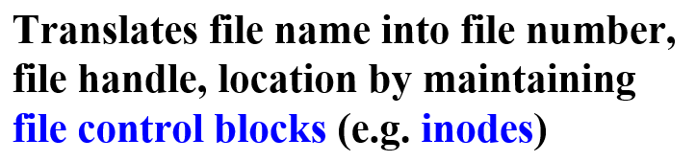
Layered File System
功能清晰
责任明确
application programs
System calls for file operations
Manages metadata information,
Manages the directory structure,
Maintains file structure via FCB.
Responsible for protection and security.
logical file system
understands files, logical address, and physical blocks
Translate logical block addresses to physical block addresses.
Free-space manager. disk allocation.
file-organization module
Issue generic commands to the appropriate device driver to read and write physical blocks on the disk. e.g. translates “retrieve block 123” to device driver.
manages memory buffers and caches (allocation, freeing, replacement). e.g. I/O buffer, disk cache for directory / data.
basic file system
I/O control
Device driver and interrupt handlers.
Transfer information between the main memory and the disk system.
Given “read drive1, cylinder 72, track 2, sector 10, into memory location 1060”.
outputs low-level hardware specific commands to hardware controller
devices

Slide 7
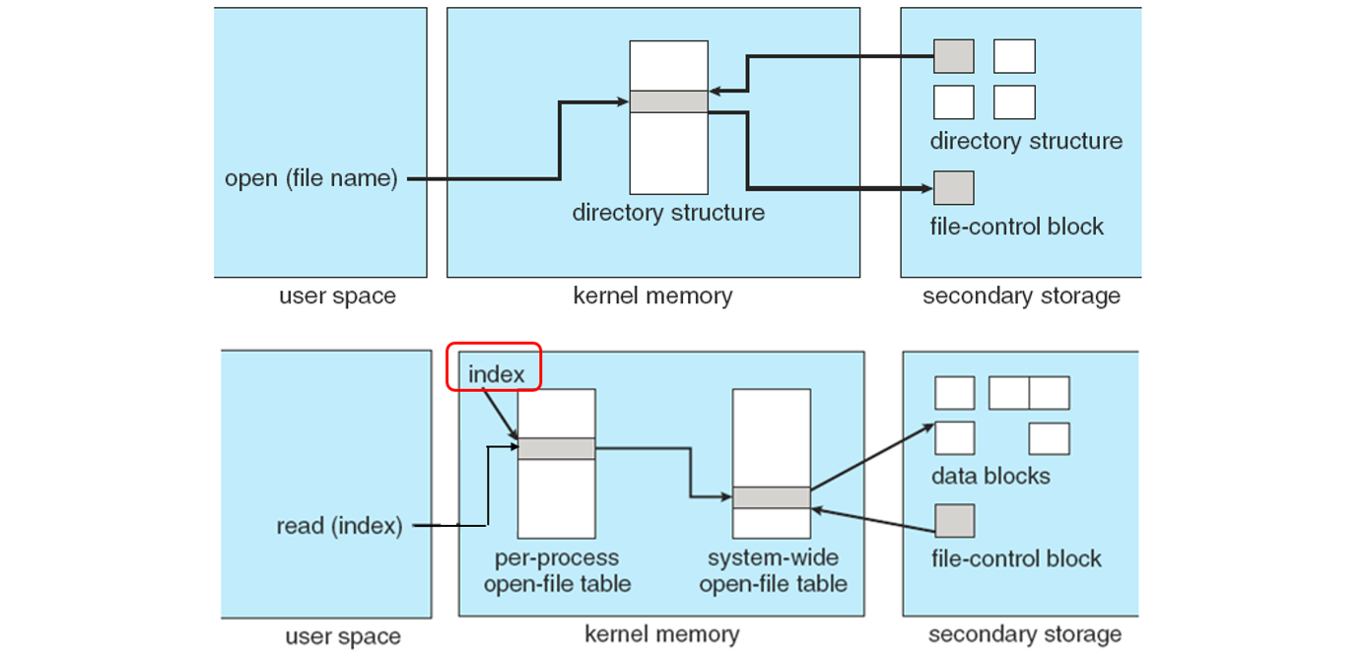
Layered File System
功能清晰
责任明确
application programs
System calls for file operations
Manages metadata information,
Manages the directory structure,
Maintains file structure via FCB.
Responsible for protection and security.
logical file system
understands files, logical address, and physical blocks
Translate logical block addresses to physical block addresses.
Free-space manager. disk allocation.
file-organization module
Issue generic commands to the appropriate device driver to read and write physical blocks on the disk. e.g. translates “retrieve block 123” to device driver.
manages memory buffers and caches (allocation, freeing, replacement). e.g. I/O buffer, disk cache for directory / data.
basic file system
I/O control
Device driver and interrupt handlers.
Transfer information between the main memory and the disk system.
Given “read drive1, cylinder 72, track 2, sector 10, into memory location 1060”.
outputs low-level hardware specific commands to hardware controller
devices

Slide 8
File Systems
Many file systems, sometimes many within an operating system，each with its own format
CD-ROM is ISO 9660. standard format agreed by manufacturers.
Unix has UFS, based on the Berkeley FFS.
Windows has FAT, FAT32, NTFS as well as floppy, CD, DVD.
Linux has more than 40 types. Standard Linux file system -- extended file system. common ext3 and ext4, plus distributed file systems, etc.
New ones still arriving
ZFS (Zettabyte File System), OpenZFS
Google GFS
Oracle ASM(Automatic Storage Management)
FUSE (Filesystem in User space), -- OMG(Omnicom Media Group)

Slide 9
12.2 File System Implementation
长期保存、按名访问、工作效率
On-disk File System Structures
In-Memory File System Structures

Slide 10
On-disk File System Structures
On-disk, the file system may contain:
information about how to boot an operating system stored there
the total number of blocks, the number and location of free blocks
the directory structure
individual files
On-disk structures
A boot control block (per volume), typically 1st block of a volume.
In UFS -- boot block, In NTFS -- partition boot sector
A volume/partition control block (per volume)
Details, the number of blocks, block size, free-block count and free-block pointers, free-FCB count and free-FCB pointers.
In UFS -- superblock, In NTFS -- Master File Table

Slide 11
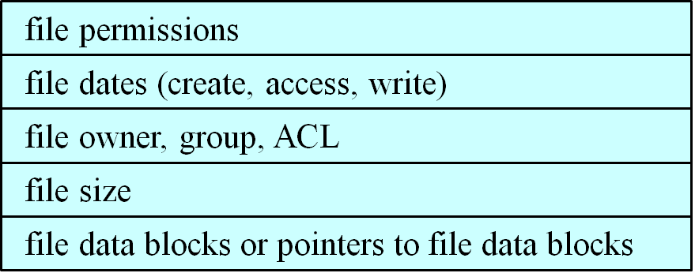
On-disk File System Structures
On-disk structures(Cont.)
A directory structure (per file system)
In UFS -- file names and associated inode numbers
In NTFS -- in Master File Table
A FCB (per file)
storage structure consisting of information about a file, including ownership, permissions, and location of the file contents.
In UFS -- inode In NTFS -- Master File Table (relational database)
A Typical File-Control Block

Slide 12
In-Memory File System Structures
Used for:
file-system management
Performance improvement via caching
In-memory structures
An in-memory mount table (partition table)
storing file system mounts, mount points, file system types.
An in-memory directory structure cache
The system-wide open-file table（one table for the system）
Contains a copy of the FCB of each open file
One entry for each open file
The per-process open-file table（One table per process ）
Contains a pointer to the appropriate entry in the system-wide open-file table.
One entry for each file opened by the process
buffers hold data blocks from secondary storage.

Slide 13
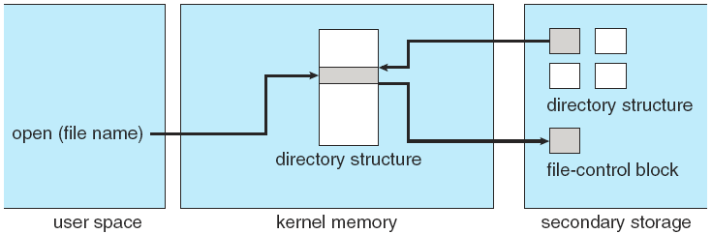
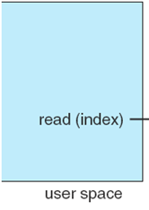
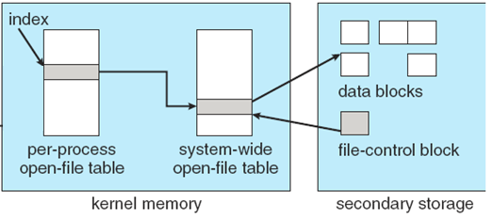
In-Memory File System Structures
A

Slide 14
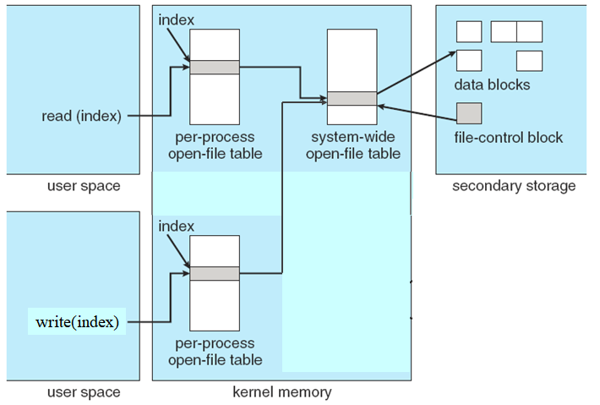
In-Memory File System Structures
A
2
B

Slide 15
Partitions and Mounting
A disk can be sliced into multiple partitions, or a partition can span multiple disks.
Each partition can either be
“raw”: containing no file system, just a sequence of blocks.
“cooked”: containing a file system.
Boot information can be stored in a separate partition, it has its own format, and is loaded into memory as an image, starts at a predefined location.
A boot loader
knows enough about the file-system structure to be able to find and load the kernel and start it executing;
understands multiple file systems and multiple operating systems can occupy the boot space.

Slide 16
Partitions and Mounting
The root partition is mounted at boot time, which contains the operating-system kernel and potentially other system files
Other partitions can be automatically mounted at boot, or manually mounted later.
At mount time, file system consistency checked
By asking the device driver to read the directory and verifying that the directory has the expected format.
Is all metadata correct?
If not, fix it, try again.
If yes, add to mount table, allow access.
Mount table – containing information about file systems that has been mounted.

Slide 17
Virtual File Systems
modern OSes must concurrently support multiple types of file systems.
how does an operating system allow multiple types of file systems to be integrated into a directory structure?
how can users seamlessly move between file-system types as they navigate the file-system space?
Virtual file system (VFS)
most OSes, including Unix, use object-oriented techniques to implement the file system.
Allow dissimilar file-system types to be implemented within the same structure, including network file systems.
simplify, organize, and modularize the implementation.
Data structures and procedures are used to isolate the basic system-call functionality from the implementation details.

Slide 18
Virtual File Systems
VFS
allows the same system call interface (the API) to be used for different types of file systems.
Separates file-system generic operations from implementation details.
Implementation can be one of many file systems types, or network file system
Implements vnodes which hold inodes or network file details.
Then dispatches operation to appropriate file system implementation routines.
The API is to the VFS interface, rather than any specific type of file system.

Slide 19
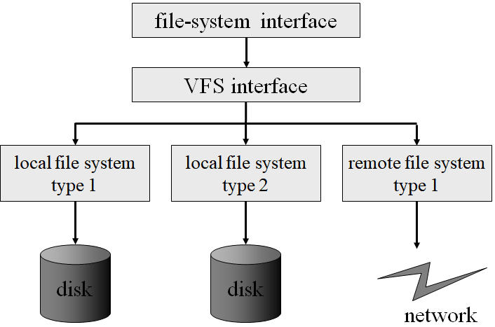
Virtual File Systems
统一接口
方便使用
based on the open(), read(), write() and close() calls and on file descriptors.
Two important functions:
Separates file-system-generic operations from their implementation.
Provides a mechanism for uniquely representing a file throughout a network. Based on Vnode, a file-representation structure. Kernel maintains one vnode structure for each active node.
Implementing the file-system type or the remote-file-system protocol

Slide 20
Virtual File Systems
For example, Linux has four object types:
inode, file, superblock, dentry
VFS defines a set of operations on the objects that must be implemented.
Every object has a pointer to a function table
Function table has addresses of routines to implement that function on that object. e.g.
int open(. . .) -- Open a file
int close(. . .) -- Close an already-open file
Ssize_t read(. . .) -- Read from a file
Ssize_t write(. . .) -- Write to a file
int mmap(. . .) -- Memory-map a file

Slide 21
11.3 Directory Implementation
Linear list of file names with pointer to the data blocks.
simple to program
time-consuming to execute
Linear search time
A sorted list allows a binary search and decreases the average search time.
A balanced tree
Hash Table – linear list with hash data structure.
decreases directory search time
collisions – situations where two file names hash to the same location
Chained-overflow
Difficulties: fixed size, hash function

Slide 22
11.4 Allocation Methods
An allocation method refers to how disk blocks are allocated for files.
Disk space is utilized effectively.
Files can be accessed quickly.
Contiguous allocation
Linked allocation
Indexed allocation

Slide 23
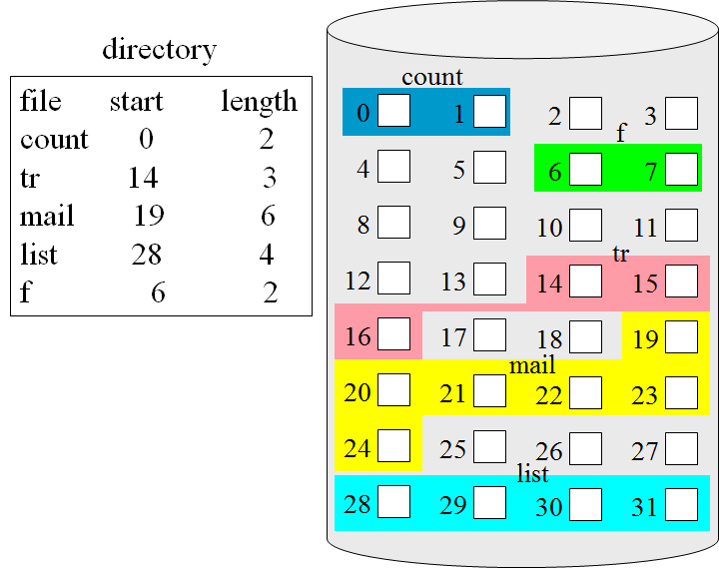
Contiguous Allocation
Single set of blocks is allocated to a file at the time of creation
each file occupies a set of contiguous blocks on the disk.
Simple
Only a single entry in the file allocation table.
only starting location (block #) and length (number of blocks) are required.
Both sequential and direct access can be supported.
Best performance in most cases.
The number of disk seeks required is minimal.
The seek time when a seek is finally needed is minimal.

Slide 24
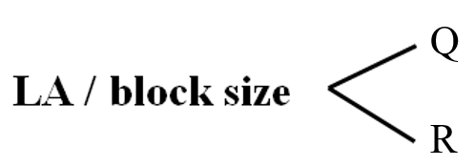
Mapping from logical to physical*
逻辑块号
块内偏移量
Block to be accessed = Q + starting address
Displacement into block = R
Example
For text file
For record file

Slide 25
连续文件举例
例如：某文件系统，磁盘块大小为 512 B
字符流文件 A，长度为 1980 B
文件A需要占用 4 个物理块。
假如分配到30、31 、32和33四个相邻的物理块中。
第33块中实际使用了444字节，剩余的68字节形成“内部碎片”。
记录文件 B，逻辑记录长 100 B，有23个记录
假设：逻辑记录不能跨物理块存放。
每个物理块中可以存放5个逻辑记录，需要5个物理块。
假设分配到第 6、7、8、9、10 块
前4块各有内部碎片12B，最后一块有212B没有使用。
LA=1248 PA=？
1980
512
1248/512 = 2..224
32th块, 224th 字节
LA=19, PA=？
512
100
23
5
19/5 = 3..4
9th 块, 400th 字节

Slide 26
总结：连续文件的地址转换
在文件说明信息中有关于存放位置的描述
开始块号、总块数（物理文件的长度）
字符流文件中逻辑地址 L
L/物理块大小，商s：逻辑块号，余数d：块内地址
物理地址：块号：开始块号+s，块内地址：d
记录文件中的逻辑记录号 n (记录不可跨块存放时)
每个物理块中可以存放逻辑记录数 m
m=物理块大小/逻辑记录大小
n/m，商s：逻辑块号，余数w：块内记录号
物理地址
块号：开始块号+s，块内地址d=逻辑记录长度*w

Slide 27
Contiguous Allocation
Problems
Difficult to find space for a new file.
First-fit, best-fit
External fragmentation
Determine how much space is needed for a file
Initial size, file grows (find a larger hole, copy file, release previous space )
Knowing the final total amount of space
compaction off-line (downtime) or on-line
Extent-Based Systems, a modified contiguous allocation scheme
An extent is a contiguous block of disks.
Extent-based file systems allocate disk blocks in extents.
A contiguous chunk of space is allocated initially, when that amount is not large enough, an extent is added.
A file consists of one or more extents.

Slide 28
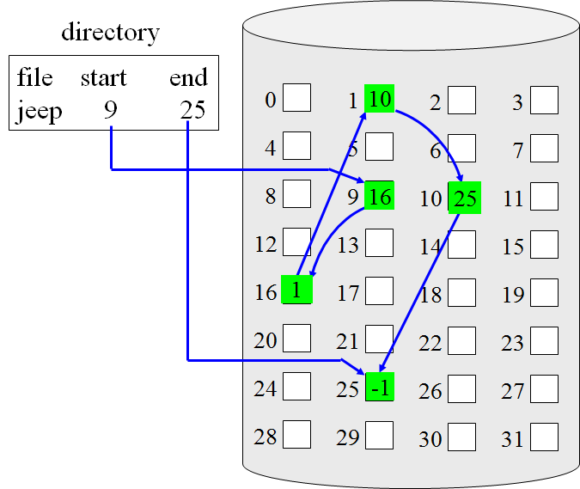
Linked Allocation
Allocation on basis of individual block.
Each file is a linked list of disk blocks: blocks may be scattered anywhere on the disk.
The directory contains a pointer to the first and last blocks of the file.
Each block contains a pointer to the next block in the chain.
There is no external fragmentation.
Any free block on the free-space list can be used to satisfy a request.
Disadvantages: No random access, Space for pointers, Reliability
block =
pointer

Slide 29

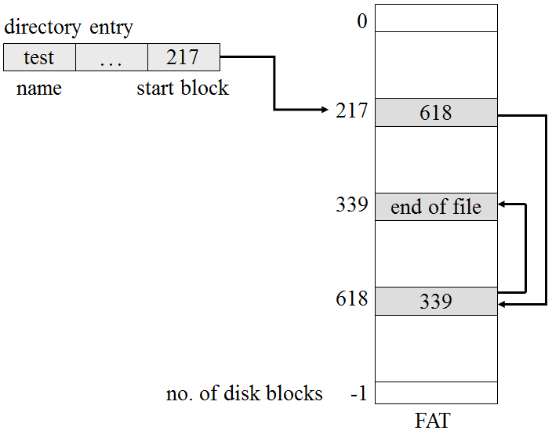
Linked Allocation
Address mapping
Block to be accessed is the Q^{th} block in the linked chain. 逻辑块号
Displacement into block = R + ptr_space 块内偏移
Locating a block can take many I/Os and disk seeks.
Improve efficiency by clustering blocks into groups but increases internal fragmentation
File-allocation table (FAT)
Simple but efficient method used by MS-DOS and OS/2
Contained in a section at the beginning of each partition.
One entry per block.
Indexed by block number.
Cached in memory

Slide 30
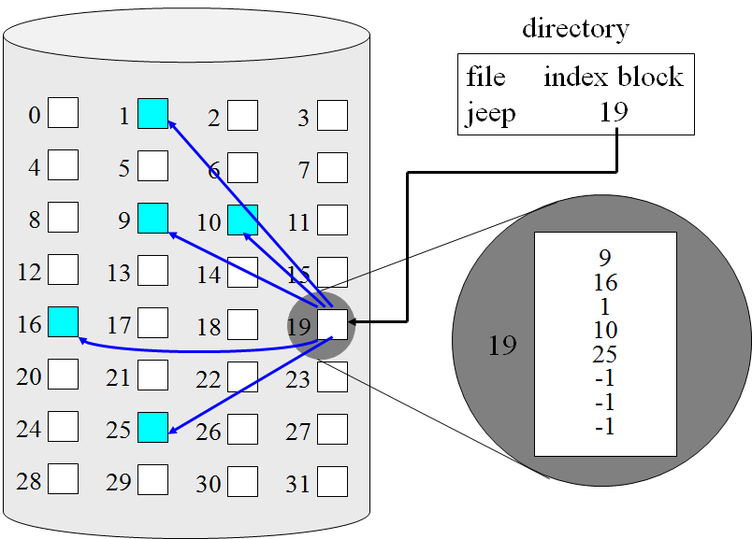
Indexed Allocation
index block：all pointers
Each file has its own index block, which is an array of disk-block addresses.
The directory contains block number for the index block.
without external fragmentation, Random access
Need index table / index block
Mapping from logical to physical in a file of maximum size of 256KB and block size of 1KB. We need only 1 block for index table.
index table
Q
Q = displacement into index table
R = displacement into block
(4B per block #)
LA / 1024
R

Slide 31
Indexed Allocation – Mapping
Mapping from logical to physical in a file of unbounded length.
Linked scheme – Link blocks of index table (no limit on size).
0
1
254
255
256
510
…
(eg. block size of 1KB)
0
1
…
…
Q₁
-- 逻辑块号
-- 块内偏移
LA / 1024
R₁
…
Q₂
-- 索引块序号
-- 索引块内偏移
Q₁ / 255
…
R₂
…
根据 Q₂ 在索引块链中找到索引块；
根据 R₂ 在索引块内偏移，取出的就是相应于 Q₁ 的物理块号。

Slide 32
Indexed Allocation – Mapping
Two-level index (maximum file size is 256*256*1KB)
0
1
…
255
0
1
…
255
256
257
…
511
…
65535
Q₁
-- 逻辑块号
-- 块内偏移
…
…
LA / 1024
R₁
0
1
…
255
…
Q₂
-- 索引块序号
-- 索引块内偏移
…
…
Q₁ / 256
R₂
…
根据 Q₂ 在外索引块内偏移，取出的是索引块的物理块号；
根据 R₂ 在该索引块内偏移，取出的是相应于 Q₁ 的物理块号。
…
…

Slide 33
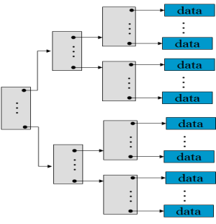
Combined Scheme: UNIX (4K bytes per block)
mode
Block size: 1KB
Direct block pointer: 12
One block pointer occupies 4 bytes
Answer the following questions:
(1) How many blocks can a file have at most?
(2) To read 255667th byte in the file, how many I/O operations are needed? (assuming inode is in memory)
owners (2)
timestamps (3)
size block
count
direct blocks
data
data
…
…
data
data
data
…
…
…
…
single indirect
data
data
double indirect
…
triple indirect
data
…
…
data

Slide 34
Answer
每个索引块可以存放1024/4=256个块号。
(1) How many blocks can a file have at most?
(2) To read 255667th byte in the file, how many I/O operations are needed?

Slide 35
Exercise 1
A file system uses 4096-byte physical blocks. Each file has a directory entry giving the file name and its location.
For contiguous file and linked file, the location consists of the first block, length of the file, and last block position. For indexed file, the location refers to the index block (Assume a file has only one index block).
Assume that the directory entry, the index block for index file, and the last physical block read is already in main memory.
Explain how to locate the disk block to be read, and how many physical blocks must be read to access the specified block (including the reading of the specified block) on a system using contiguous allocation, linked allocation, and indexed allocation.
(Assume block numbers start with 1.)
(1) Assume the last block read is 100, and the block to be read is 80.
(2) Assume the last block read is 120, and the block to be read is 188.

Slide 36
Answer
(1) Assume the last block read is 100, and the block to be read is 80.
contiguous allocation:
linked allocation:
indexed allocation:
(2) Assume the last block read is 120, and the block to be read is 188.
contiguous allocation:
linked allocation:
indexed allocation:

Slide 37
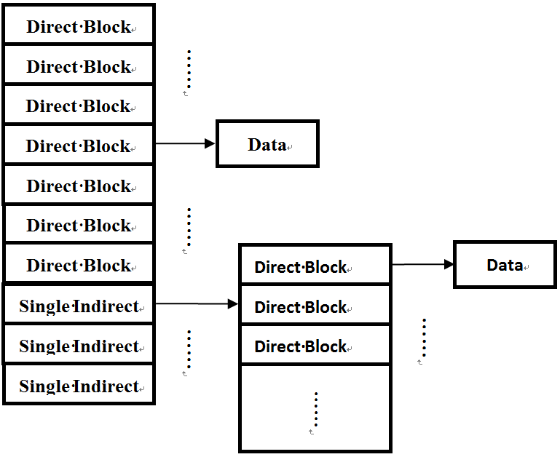
Exercise 2
A file system, its allocation scheme is as follows：
each file, only one block can be used as inode, in which, 10 block numbers can be hold at most, 7 point to data blocks and 3 Single indirect blocks.
(1) How many blocks is the largest size of a file?
(2) There is a file F with 30 Blocks. If we want to access the 5th Block in this file, how many blocks we need to access ? (assuming all Blocks is not in memory)
Answer:
(1)
(2)

Slide 38
Performance
Best method depends on file access type
Contiguous great for sequential and random
Linked good for sequential, not random
Declare access type at creation ==> select either contiguous or linked.
Indexed more complex
Depends on the index structure, on the size of the file, and on the position of the block desired.
Single block access could require:
2 I/Os, 1 for index block read, then 1 for data block read.
3 I/Os, 2 for index block read, then 1 for data block read.
Clustering can help improve throughput, reduce CPU overhead
combine contiguous allocation with indexed allocation by
using contiguous allocation for small files (up to three or four blocks)
automatically switching to an indexed allocation if the file grows large.

Slide 39
11.5 Free-Space Management
Bit map / Bit vector
Linked list
Grouping
Counting

Slide 40


Bit Map
Each block is represented by 1 bit.
For example, n blocks
W
31 30 16 15 2 1 0
b
0
1
2
3
0 | 0 | 0 | 0 | 0 | 0 | 0 | 0 | 0 | 0 | 0 | 0 | 0 | 0 | 0 | 0 | 0 | 0 | 0 | 0 | 0 | 0 | 0 | 0 | 0 | 0 | 0 | 0 | 0 | 0 | 0 | 0
0 | 0 | 0 | 0 | 0 | 0 | 0 | 0 | 0 | 0 | 0 | 0 | 0 | 0 | 0 | 0 | 0 | 0 | 0 | 0 | 0 | 0 | 0 | 0 | 0 | 0 | 0 | 0 | 0 | 0 | 0 | 0
0 | 1 | 1 | 1 | 0 | 0 | 1 | 0 | 1 | 1 | 0 | 0 | 1 | 1 | 0 | 1 | 0 | 1 | 1 | 1 | 1 | 1 | 1 | 1 | 1 | 1 | 0 | 0 | 1 | 1 | 0 | 0
66
Calculation of the first free block number:
(number of bits per word)*(number of 0-value words)+offset of first 1 bit
CPUs have instructions to return offset within word of first “1” bit.
allocate 1 block?
release 84、85?

Slide 41
Bit Map
Bit map requires extra space.
Example:
block size = 4KB = 2¹² bytes
disk size = 2³⁰ bytes (1 gigabyte)
n = 2³⁰/2¹² = 2¹⁸ bits (2¹⁵ bytes or 32K bytes)
256G ==> 8 MB of memory
Example:
block size = 4KB = 2¹² bytes
disk size = 2⁴⁰ bytes (1 terabyte)
n = 2⁴⁰/2¹² = 2²⁸ bits (or 32MB)
if clusters of 4 blocks ==> 8MB of memory
Easy to get contiguous files space.

Slide 42
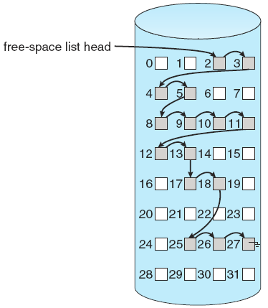

Linked List
File system maintains free-space list to track available blocks/clusters
To link together all the free disk blocks.
keeping a pointer to the first free block in a special location on the disk and caching it in memory.
Records the total number of free blocks.
No waste of space
Cannot get contiguous space easily.
No need to traverse the entire list (if # free blocks recorded).

Slide 43
Grouping
Modify linked list to store address of next n-1 free blocks in first free block, plus a pointer to next block that contains free-block-pointers (like this one)
1′
1
2′
…
n-1′
n′
1″
2″
…
n-1″
n″
UNIX
…

Slide 44
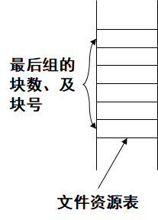
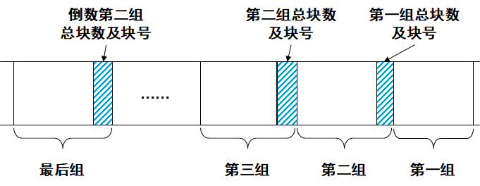
UNIX成组链接的方法
把文件存储设备中的所有空闲块从后向前，按50块为一组进行划分。
每组的第一块用来存放前一组中各块的块号和总块数。
由于第一组前面已无其他组存在，因此第一组为49块。
由于存储空间不一定正好是50的整数倍，所以最后一组有可能不足50块。
由于该组后边已经没有其他组了，所以最后一组的块号与总块数只能放在管理文件存储设备的文件资源表中。

Slide 45
UNIX成组链接的方法示例
物理块号
物理块号
物理块号
50
回收10个
物理块后
50
50
49
49
49
48
3
ptr
……
……
15
84
……
ptr
20
分配43个
物理块后
20
20
5
5
ptr
5
4
36
4
36
4
36
3
42
3
42
3
42
2
55
2
55
2
55
1
68
1
68
1
68
堆栈
堆栈
堆栈

Slide 46
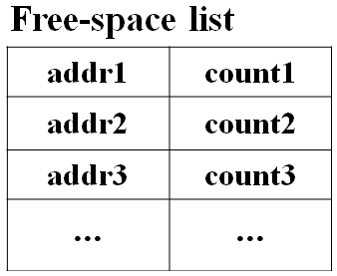
Counting
Because space is frequently contiguously used and freed, with contiguous-allocation allocation.
Keep address of first free block and count of following free blocks.
Free space list then has entries containing addresses and counts.
Similar to the extent or clustering method of allocating blocks.
Entries can be stored in a balance tree, rather than a linked list, for efficient lookup, insertion, and deletion.

Slide 47
Free-Space Management
Need to protect:
Pointer to free list
Bit map
Must be kept on disk
Copy in memory and disk may differ.
Cannot allow for block[i] to have a situation where bit[i] = 0 in memory and bit[i] = 1 on disk.
Solution:
Set bit[i] = 0 on disk.
Allocate block[i]
Set bit[i] = 0 in memory

Slide 48

课后作业与研究性学习
作业
掌握目录结构
文件磁盘空间的分配/组织方法
逻辑地址到物理地址的转换
研究性学习
比较不同的分配方法的优缺点
分析影响文件系统的效率与性能的因素
A1：openEuler
文件系统
A2：openEuler
VFS

Slide 49
A1: openEuler文件系统
openEuler 文件系统整体架构
文件操作
I/O性能优化
多级索引
Extent

Slide 50
openEuler 文件系统整体架构

Slide 51
Ext4文件系统
4th Extended File System
2006年，美国软件工程师Theodore Ts’o 发布
支持1EB的存储空间、16TB的文件大小
在线整理碎片，将一个文件的不同部分尽可能地存储到一个连续的物理位置。
发展历程
MINIX文件系统（Andrew Tannenbaum），支持64MB的存储空间、文件名长度14个字符。
Ext，1992年，法国Remy Card，支持2GB存储空间，文件名长255个字符。
Ext2，1993年，Remy Card，支持TB级存储，单个文件大小GB级。
Ext3，1998年，英国Stephen Tweedie，引入日志机制。支持16TB存储空间、2TB文件大小。

Slide 52
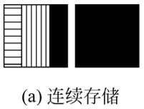
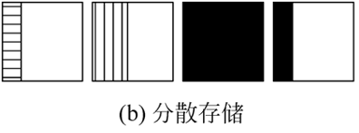
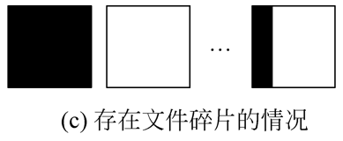
基本实现：数据结构级磁盘布局
文件的存储
一个块只存储属于一个文件内容
一个文件的内容可以存放在不连续的多个数据块中。
3个文件：1KB、2KB、5KB
碎片
元数据
inode, bitmap, superblock

Slide 53
基本实现：整体布局
早期：简单、性能低
Ext4：
多个块组
块组结构：
引导块：分区的第一个块
只存在于块组0中，不能被修改
OS分区，引导程序
超级块
块组0中：主超级块
块组3、5、7及其幂中：副本
块组描述符，所有块组描述符构成块组描述符表（GDT）

Slide 54
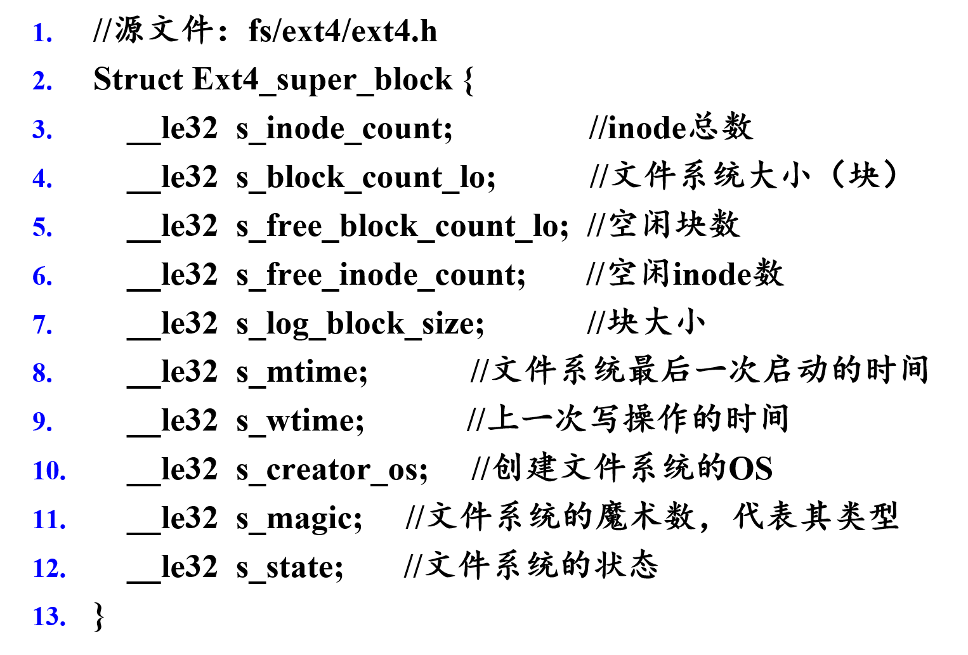
基本实现：超级块
固定大小：1KB
部分成员:

Slide 55
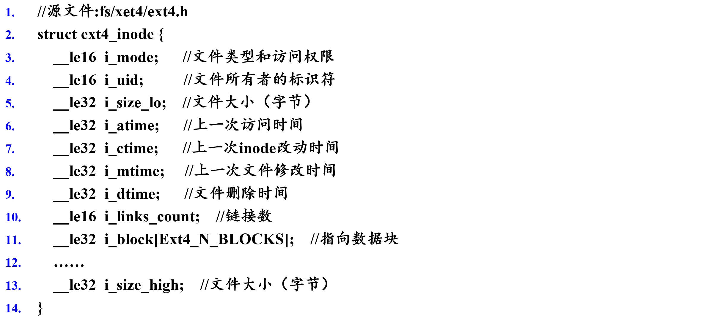
基本实现：文件的索引

Slide 56
基本实现：文件的索引
inode表与数据块的关系示例

Slide 57
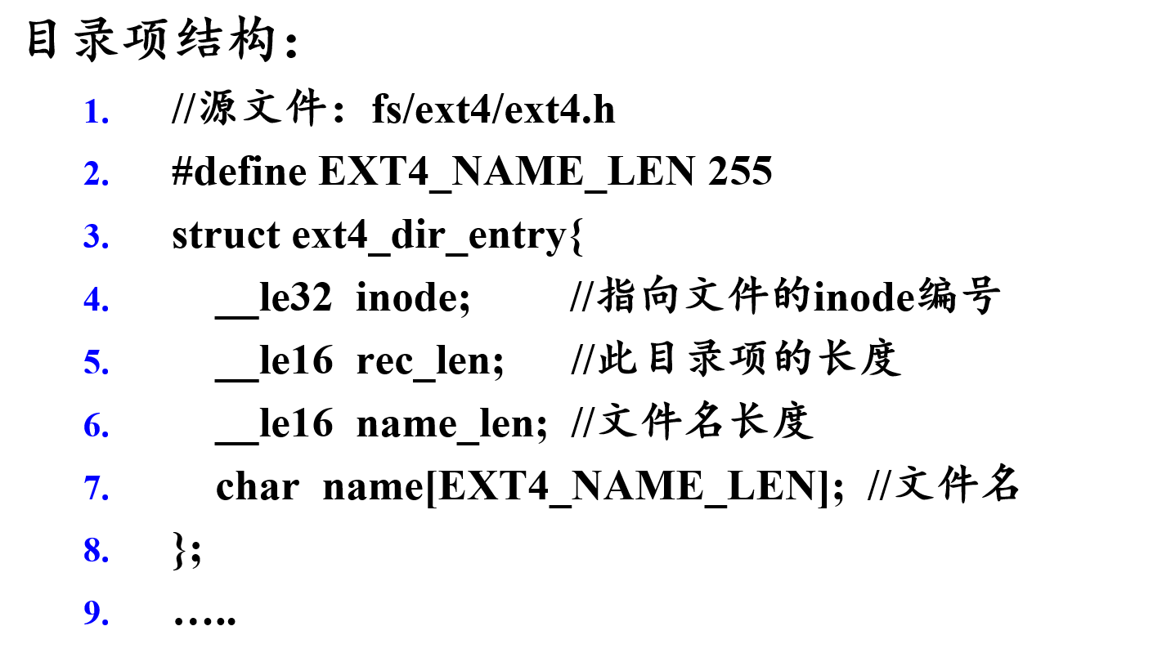
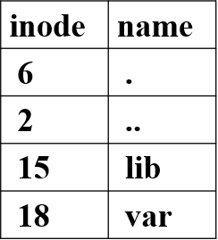
基本实现：目录的存储
目录文件
目录项的结构：
如：lib的文件内容：

Slide 58
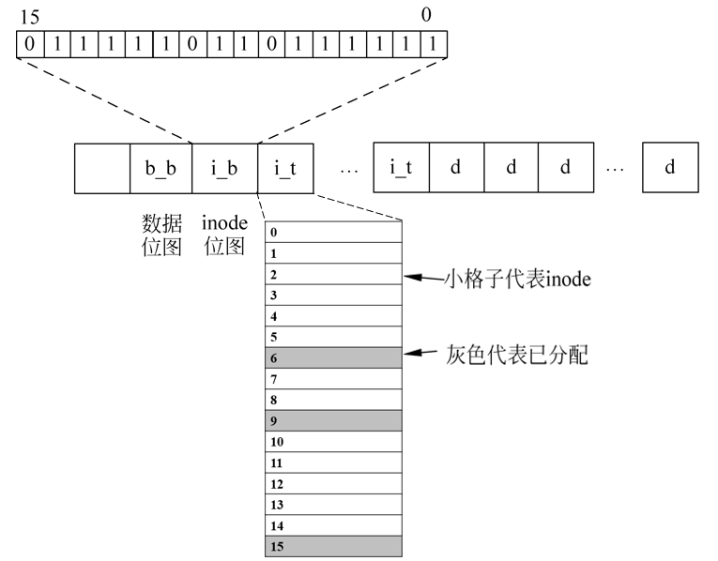
基本实现：空闲块管理
位图（bitmap）
数据位图 / inode位图
bit=1: free bit=0: used
假定：
块大小：4KB
inode大小：256B
每块可存inode个数：16
inode位图i_b需要设置为16个bit，即使只需要16个bit的空间，位图也至少会使用一个磁盘块。
4KB的位图最多可记录 4*1024*8 个inode块的使用状态。

Slide 59
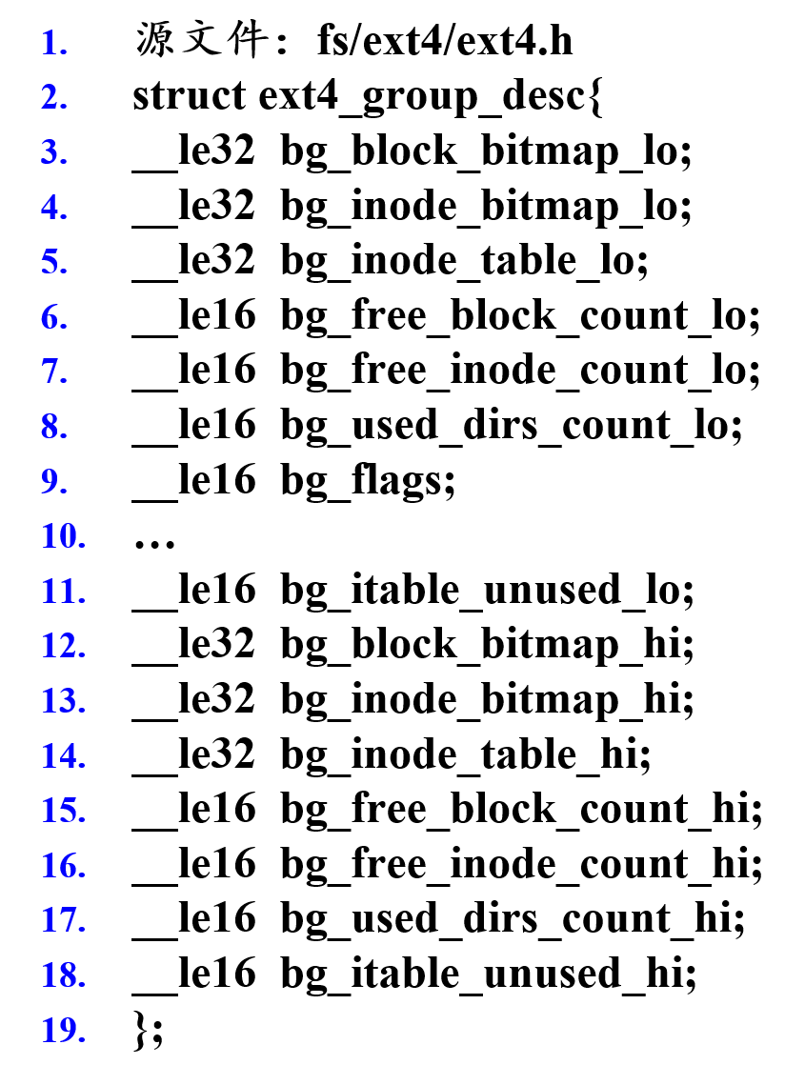
基本实现：块组描述符
块组：
一个或多个物理上连续的磁盘块组成
GD（Group Descriptor）
数据位图的地址
inode 位图的地址
inode表的地址
空闲数据块的数目
可用inode数
目录数
未使用inode表数

Slide 60
文件操作：open
函数原型：
int open(const char *pathname, int flags, mode_t mode);
int open(const char *pathname, int flags);
参数：
flags：访问模式
必选：O_RDONLY / O_WRONLY / O_RDWR
可选：O_APPEND / O_CREAT
返回值：
成功：非负整数（索引值），0~OPEN_MAX（limit.h） 指向进程打开文件表该文件对应的item entry
失败：-1

Slide 61
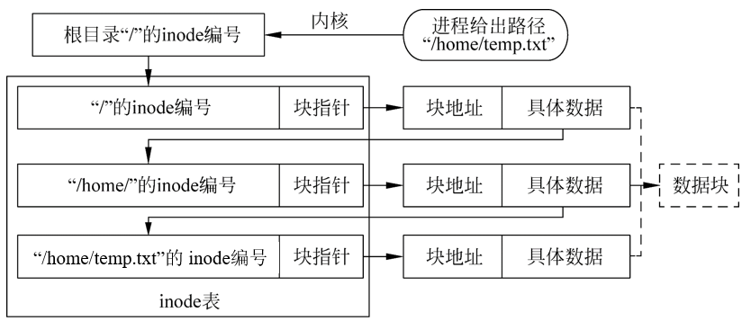
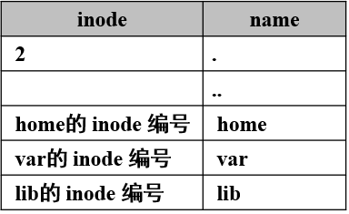
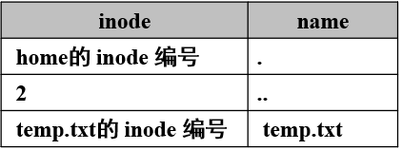
文件操作：open
Open(“/home/temp.txt”, O_RDWR)
根目录“/”的inode编号在文件系统中时固定的，其值为2。
对每级目录，至少进行2次磁盘I/O：
（1）读取该级目录的inode；（2）读取该inode映射的数据块

Slide 62
文件操作：read / write
Read
根据inode提供的信息获取待读取数据块的位置；
读取数据；
更新打开文件表中的读写指针
I/O次数
读取文件的数据块
更新inode（访问时间）
Write
为用户分配新的数据块
读取数据位图，获取数据块的使用情况
更新数据位图
更新文件的inode（打开文件表中）
写入用户数据到分配的数据块中
I/O次数
读取数据位图
更新数据位图
向数据块中写数据
更新inode（数据块的位置、访问时间）

Slide 63
I/O性能优化
硬盘I/O性能，取决于其访问模式：寻道、盘片旋转、传输数据
评价文件系统性能，主要指标：
响应时间（Response Time）：时延、或者服务时间 OS内核发起读写请求到IO处理完成的时间。
数据传输率（Data Transfer Rate）：用于衡量磁盘顺序读写的能力 磁盘每秒最大能处理的数据传输量。
每秒读写次数（Input/Output Operations Per Second, IOPS）：用于衡量磁盘随机读写的能力 每秒钟处理的IO请求数量。
block cache

Slide 64
I/O性能优化：写缓冲技术
延迟写
文件的写操作，不直接进入磁盘，先在缓冲区等待。
优点：
批量写磁盘，减少写操作开销；
如连续出现对同一元数据的写操作，延迟写可避免不必要的写操作。
缺点：
如系统崩溃，未写入磁盘的数据将丢失。
需要平衡：持久性和性能
持久性：尽快写磁盘
性能：延迟写
延迟块分配（delayed allocation）
将块分配的时间推迟到页面刷新时（即数据从缓存写入磁盘时）
可将多个块分配请求合并为单个块分配请求
避免为一些没有持久化需求的临时文件执行不必要的块分配。
可将同一个文件的数据块尽可能地放置在连续的磁盘空间。
缓存的主要目的：弥补告诉设备与低速设备之间的速度差距。
缓冲的主要目的：集中处理多次突发的磁盘I/O请求，减少I/O次数。

Slide 65
多级索引
Ext3 采用三级索引
12个直接指针
1个间接指针
1个二级间接指针
1个三级间接指针

Slide 66
Extent
Ext4，引入extent方式
inode 的i_block成员中保存的是一个描述B+树的数据结构——Extent树
在Extent树中：
一个文件的多个连续物理块构成一个逻辑块。
使用一个指针加上一个以块为单位的长度指定数据块的磁盘位置。
三种重要数据结构：
Extent头（ext4_extent_header）
Extent索引（ ext4_extent_idx）
Extent项（ ext4_extent）

Slide 67
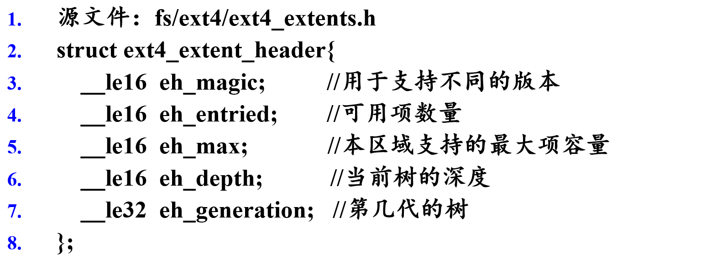
Extent： Extent头
位于Extent树中每个磁盘逻辑块的起始位置。
描述该逻辑块的B+树属性，即数据的类型和数量。
树的深度为0：该逻辑块中的数据项为B+树的叶子节点，其中存储的是Extent项。
书的深度待遇0：该逻辑块中的数据项为B+树的非叶子节点，其中存储的是Extent索引。指向树的下一级结构。

Slide 68
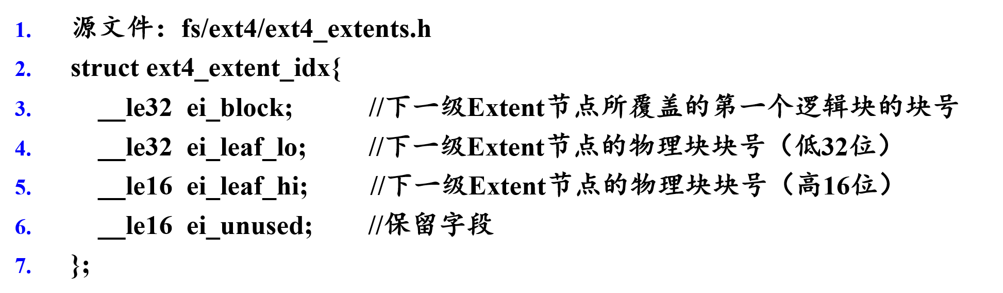
Extent：Extent索引
B+树的索引节点，用于指向下一级逻辑块。

Slide 69
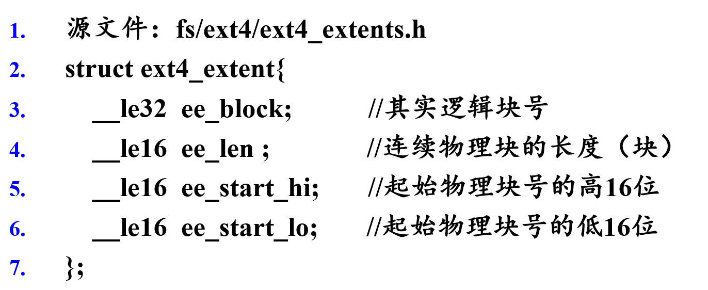
Extnt： Extent项
描述逻辑块号与物理块号之间的关系
物理结构：
一个逻辑块可以包含2¹⁵个连续物理块
数据结构：

Slide 70
Extent：逻辑块到物理块的映射过程

Slide 71
Extent：Extent树示例

Slide 72
A2: openEuler VFS
openEuler VFS 概述
VFS数据结构

Slide 73
openEuler VFS 概述
各类文件系统的管理者
向用户提供通用、统一的API
POSIX
支持的物理文件系统
基于磁盘的文件系统，Ext2、Ext3、Ext4、ReiserFS、JFS、XFS、FAT32、VFAT、NTFS等
基于网络的文件系统，NFS、SMB、OCFS等
特殊的文件系统，PROC、SYSFS。
VFS接口：VFS向下层物理文件系统提供的接口。
VFS的目录结构：树形结构（目录树）
顶层：根目录
磁盘分区上的文件系统挂载在VFS目录树的某个目录下，分支目录。

Slide 74
API处理示例
VFS通过系统调用函数sys_write()处理与设备无关的操作；
Sys_write()调用物理文件系统在VFS中注册的写操作函数，如 Ext4：ext4_file_write_iter()
ext4_file_write_iter()处理与设备相关的操作，将数据写入磁盘文件。

Slide 75
VFS数据结构
类似于物理文件系统的数据结构，但只存在于内核中。
采用面向对象的设计。
定义了一套统一的数据结构表示通用文件系统对象。
超级块对象
索引节点对象
目录项对象
文件对象

Slide 76
VFS数据结构：超级块对象
存储物理文件系统的信息。
对应存放在磁盘特定扇区中的物理文件系统超级块中或物理文件系统控制块中。
物理文件系统被挂载到VFS目录下时，VFS调用alloc_super()从磁盘读取物理文件系统超级块中的内容，并将读取到的信息填充到内存的超级块对象中。

Slide 77
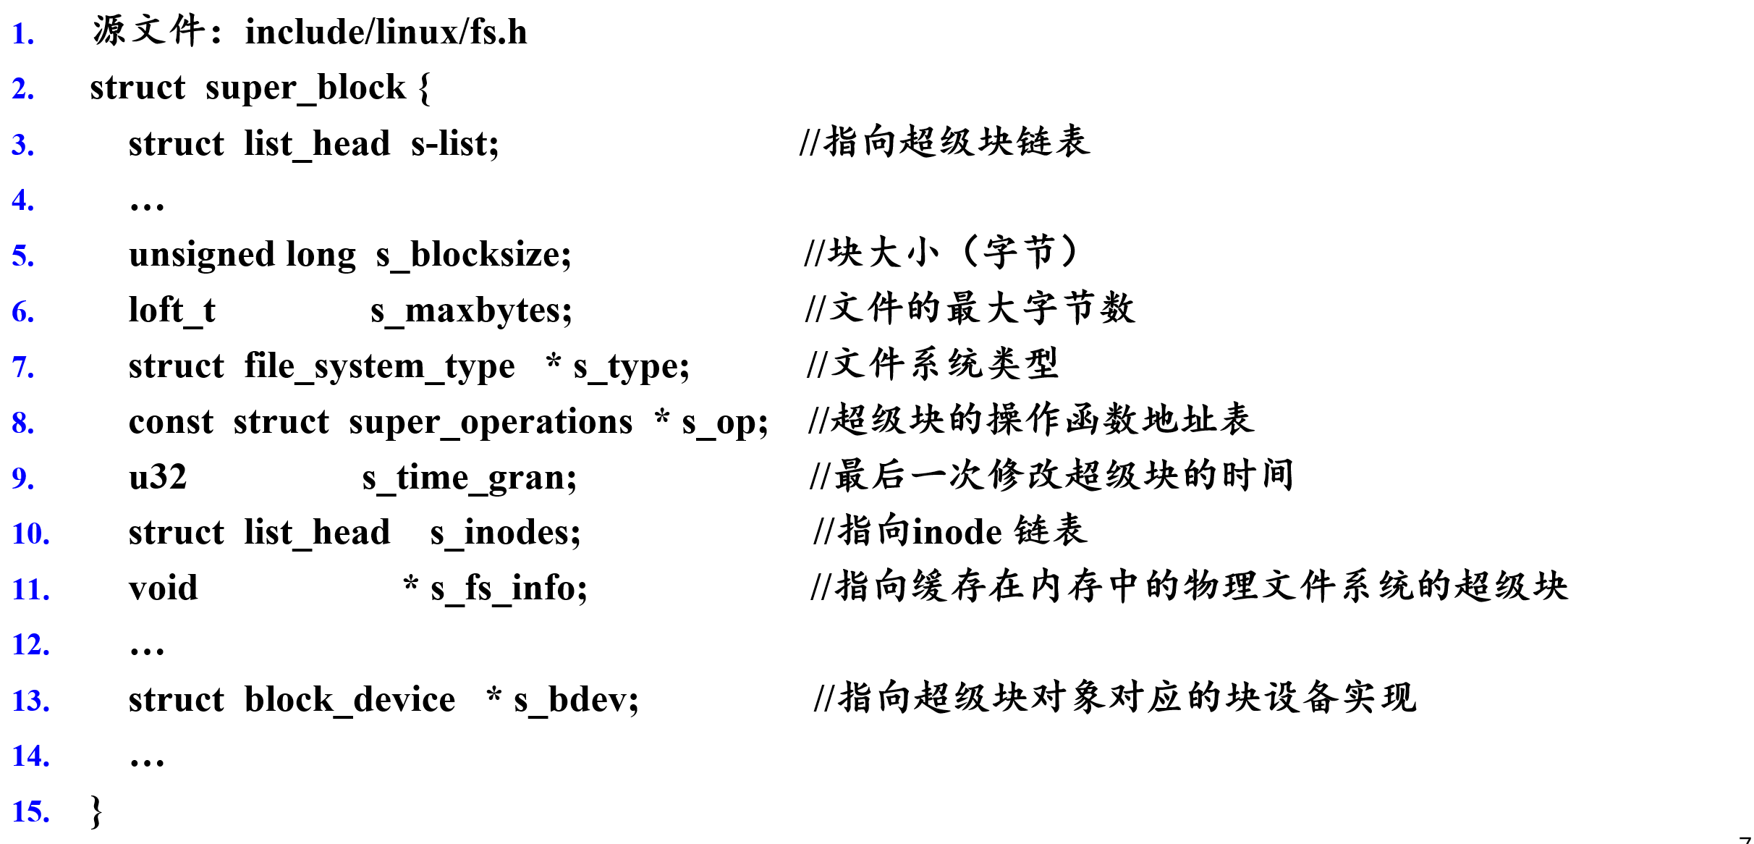
超级块对象

Slide 78
VFS数据结构：索引节点对象
代表物理文件系统中的一个文件
包含了内核在操作文件或目录时需要的全部信息
需要从磁盘索引节点读入
对应的时磁盘上的索引节点

Slide 79
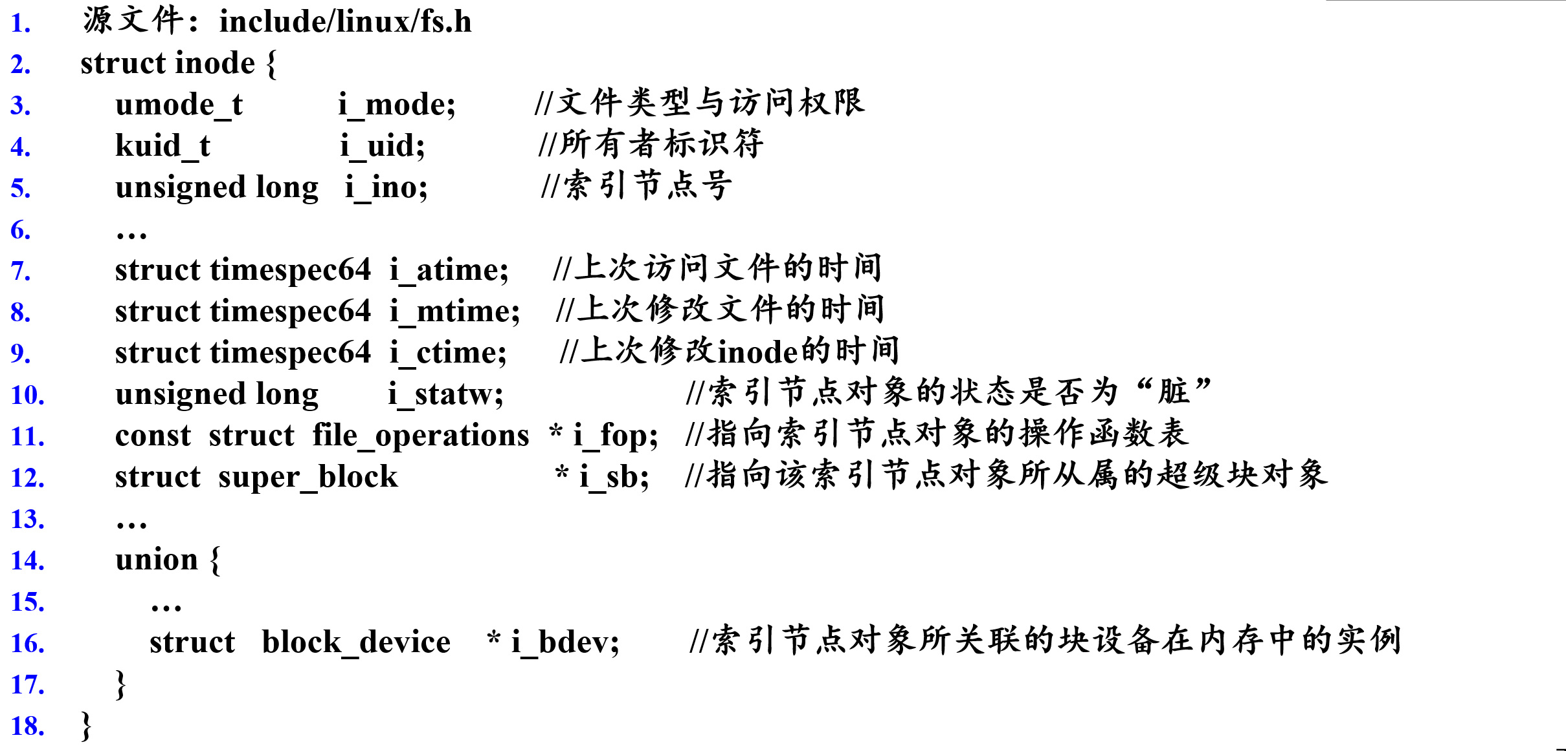
索引节点对象

Slide 80
VFS数据结构：目录项对象
代表文件路径中的一个组成部分
“/home/temp.txt”，“/”、子目录home、文件temp.txt都属于目录项对象
包含了与文件路径相关的内容
目录对象的名称、父目录的目录项对象的指针、子目录项对象组成的链表等
由VFS构建，在磁盘中没有对应的磁盘数据结构
不需要写回磁盘
在执行路径名查找操作时，VFS会将目录项缓存下来
下次查找时，先查缓存， 如在缓存中没找到，则访问物理文件系统加载相关信息，并创建目录项对象和索引节点对象。

Slide 81
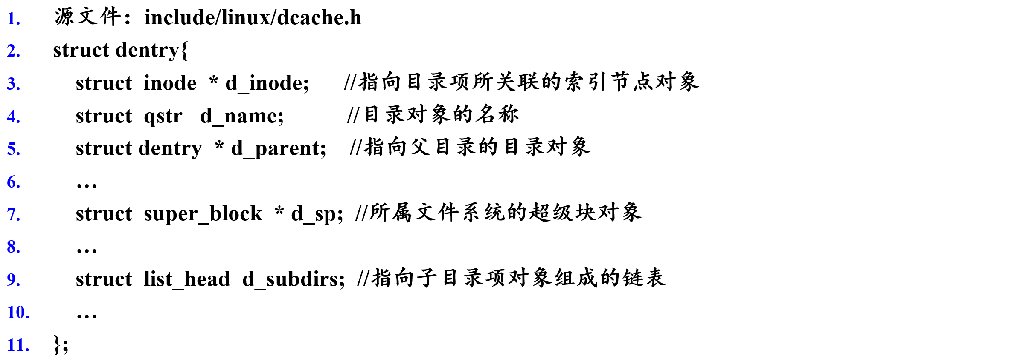
目录项对象

Slide 82
VFS数据结构：文件对象
当进程使用open()打开一个文件时，VFS创建一个文件对象
代表进程已经打开的文件，是已打开文件在内核中的表示
记录着进程操作已打开文件的状态信息
还包含指向物理文件系统对函数open()等操作具体实现的函数集合指针
Ext4，open()操作的具体实现函数是ext4_file_open()
文件对象没有对应的磁盘数据。

Slide 83
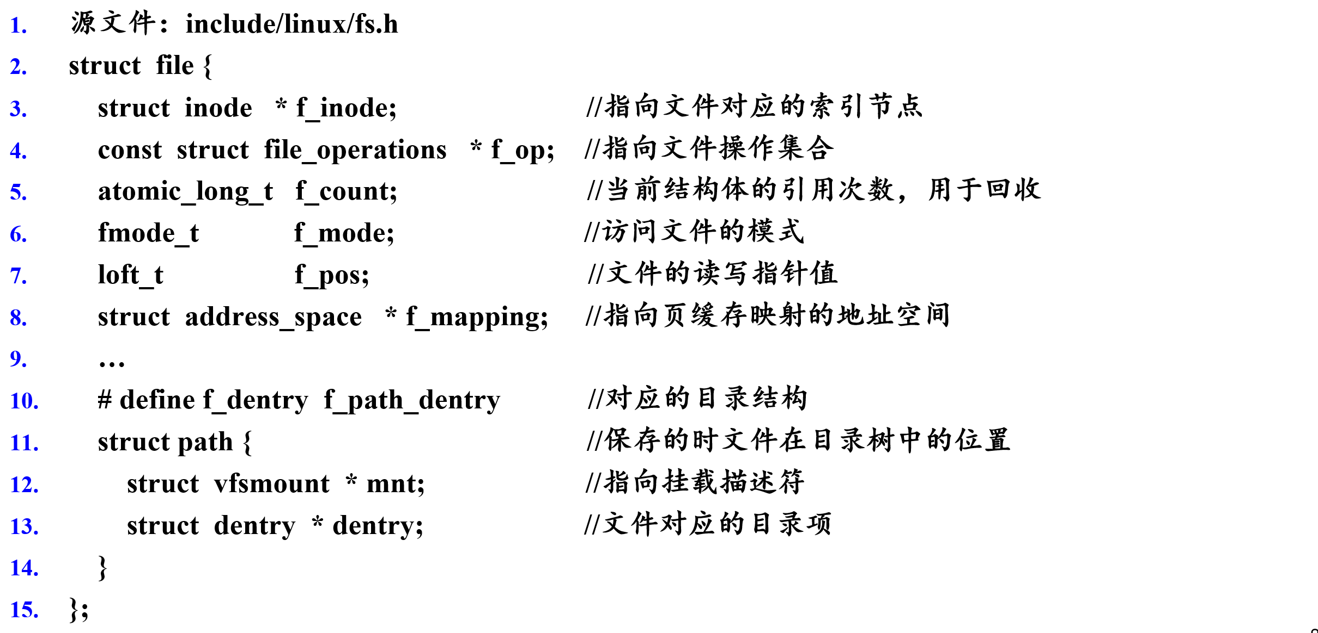
文件对象

Slide 84
VFS数据结构：四种对象之间的关系

